Slide 1
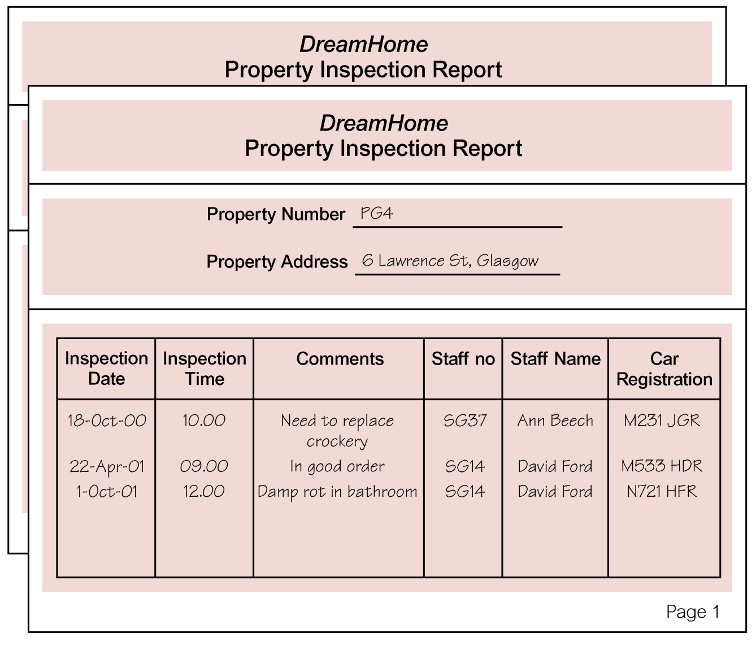
Quiz (UNF to 3NF)

Slide 2
Boyce-Codd Normal Form
“A relation is in Boyce-Codd Normal Form if and only if every determinant is a candidate key.”

Slide 3
Violation of BCNF
STUDENT_ADVISOR
SID | Major | Advisor | Maj_GPA
123 | Physics | Hawking | 4.0
123 | Music | Mahler | 3.3
456 | Literature | Michener | 3.2
789 | Music | Bach | 3.7
678 | Physics | Hawking | 3.5
Candidate Keys
SID, Major
SID, Advisor
Dependencies
(SID, Major) → Advisor
(SID, Major) → Maj_GPA
(SID, Advisor) → Maj_GPA
Advisor → Major

Slide 4
Method to Achieve BCNF
The determinant that is not a candidate key becomes a component of the primary key of the revised table.
Student_Advisor (SID, Advisor, Major_GPA)
Create a new table containing all the columns from the old table that depend on this determinant.
Advisor (Major)
Make the determinant the primary key of this new table.
Advisor (Advisor, Major)

Slide 5
Tables in BCNF
STUDENT_ADVISOR
ADVISOR
SID | Advisor | Maj_GPA
123 | Hawking | 4.0
123 | Mahler | 3.3
456 | Michener | 3.2
789 | Bach | 3.7
678 | Hawking | 3.5
Advisor | Major
Hawking | Physics
Mahler | Music
Michener | Literature
Bach | Music

Slide 6
Lossless Decomposition
Definition:
A decomposition of a relation R is a set of relations {R1, R2, …, Rn} such that:
- each Ri is a subset of R
- the union of the Ri is R ( Ri = R )
Definition of “Lossless Decomposition”:
A decomposition {R1, R2, …, Rn} of a relation R is called “Lossless Decomposition”: for R if the natural join of R1, R2, …, Rn produces exactly the relation R.
Not every decomposition is lossless.

Slide 7
Lossless decomposition
To normalise a relation, we used projections
If R(A,B,C) satisfies A→B then we can project it on A,B and A,C without losing information
Lossless decomposition:
R = π_{AB}(R) ⋈ π_{AC}(R)
where π_{AB}(R) is projection of R on AB and ⋈ is natural join.
Reminder of projection:
R
π_{AB}(R)
π_{AC}(R)
A
B
C
A
B
A
B

Slide 8
Relational algebra reminder: selection
σ_{C=D}(R)
R
A
B
C
D
A
B
C
D
1
x
c
c
1
x
c
c
2
y
d
e
3
z
a
a
3
z
a
a
4
u
b
c
5
w
c
d

Slide 9
Relational algebra reminder: product
R1
R2
R1×R2
A
B
A
C
A
B
A
C
1
x
1
w
1
x
1
w
2
y
2
v
1
x
2
v
3
u
1
x
3
u
2
y
1
w
2
y
2
v
2
y
3
u

Slide 10
While I am on the subject…
SELECT A,B
FROM R1, R2, R3
WHERE (some property α holds)
translates into relational algebra
π _{A,B} σ _{α} (R1×R2×R3)

Slide 11
Relational algebra: natural join R1⋈R2 = π_{R1.A,B,C} σ_{R1.A = R2.A} (R1×R2)
R1
R2
R1 ⋈ R2
A
B
A
C
A
B
C
1
x
1
w
1
x
w
2
y
2
v
2
y
v
3
u

Slide 12
When is decomposition lossless: Module → Lecturer
R
π _{Module,Lecturer}R
π _{Module,Text}R
Module
Lecturer
Text
Module
Lecturer
Module
Text
DBS
nza
CB
DBS
nza
DBS
CB
DBS
nza
UW
RDB
nza
DBS
UW
RDB
nza
UW
APS
rcb
RDB
UW
APS
rcb
B
APS
B

Slide 13
When is decomposition is not lossless: no fd
S
π _{First,Last}S
π _{First,Age}S
First
Last
Age
First
Last
First
Age
John
Smith
20
John
Smith
John
20
John
Brown
30
John
Brown
John
30
Mary
Smith
20
Mary
Smith
Mary
20
Tom
Brown
10
Tom
Brown
Tom
10

Slide 14
When is decomposition is not lossless: no fd
π _{First,Last} S ⋈ π _{First,Last} S
π _{First,Last}S
π _{First,Age}S
First
Last
Age
First
Last
First
Age
John
Smith
20
John
Smith
John
20
John
Smith
30
John
Brown
John
30
John
Brown
20
Mary
Smith
Mary
20
John
Brown
30
Tom
Brown
Tom
10
Mary
Smith
20
Tom
Brown
10

Slide 15
Denormalisation
Normalisation
Removes data redundancy
Solves INSERT, UPDATE, and DELETE anomalies
This makes it easier to maintain the information in the database in a consistent state
However
It leads to more tables in the database
Often these need to be joined back together, which is expensive to do
So sometimes (not often) it is worth ‘denormalising’

Slide 16
Denormalisation
You might want to denormalise if
Database speeds are unacceptable (not just a bit slow)
There are going to be very few INSERTs, UPDATEs, or DELETEs
There are going to be lots of SELECTs that involve the joining of tables
Address
Number
Street
City
Postcode
Not normalised since
{Postcode} → {City}
Address1
Number
Street
Postcode
Address2
Postcode
City

